Slide 1
CORAL
A Real-time Sentry for the World’s Oceans
Developed by Joseph Farah in Python

Slide 2
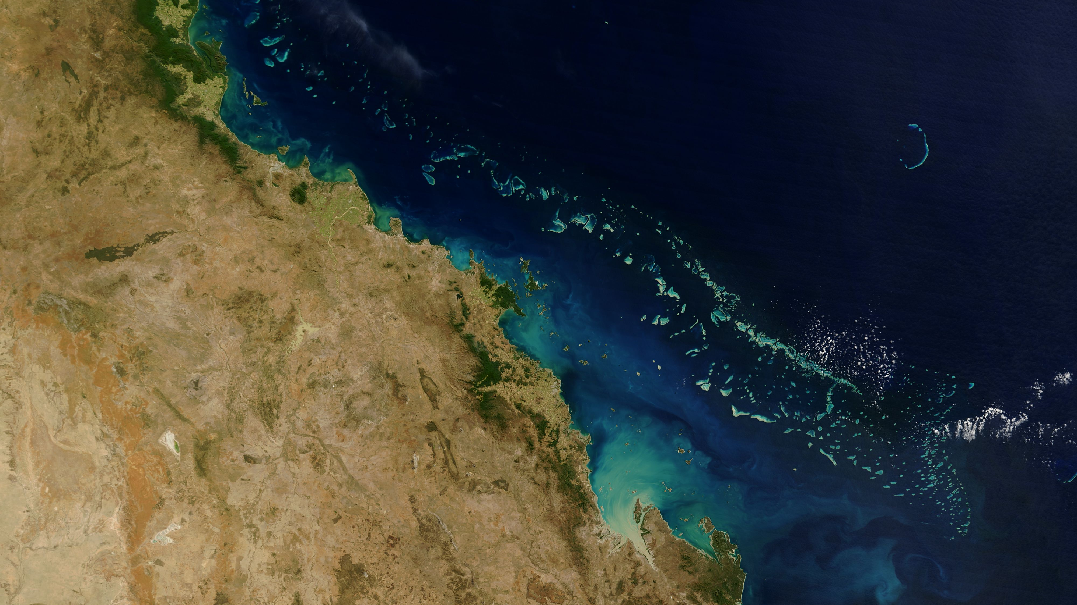
What are coral?
A living creature—thousands of colonies of tiny coral polyps calcifying limestone to form hard outer shells, closely related to jellyfish
Home to 25% of the world’s marine life
Helps direct the course of evolution in the ocean
Coral reef plants and animals are important sources of new medicines being developed to treat cancer, arthritis, human bacterial infections, Alzheimer’s disease, heart disease, viruses, and other diseases. (Source: NOAA)

Slide 3
The reefs are dying.
93% of climate change heat is absorbed by the ocean
Coral reefs require specific pH ranges
Support 25% of all marine life, despite covering only 1% of the ocean floor
60% of the world’s reefs are threatened by human activity
99% of the world’s reefs are projected to experience bleaching in the next few decades

Slide 4
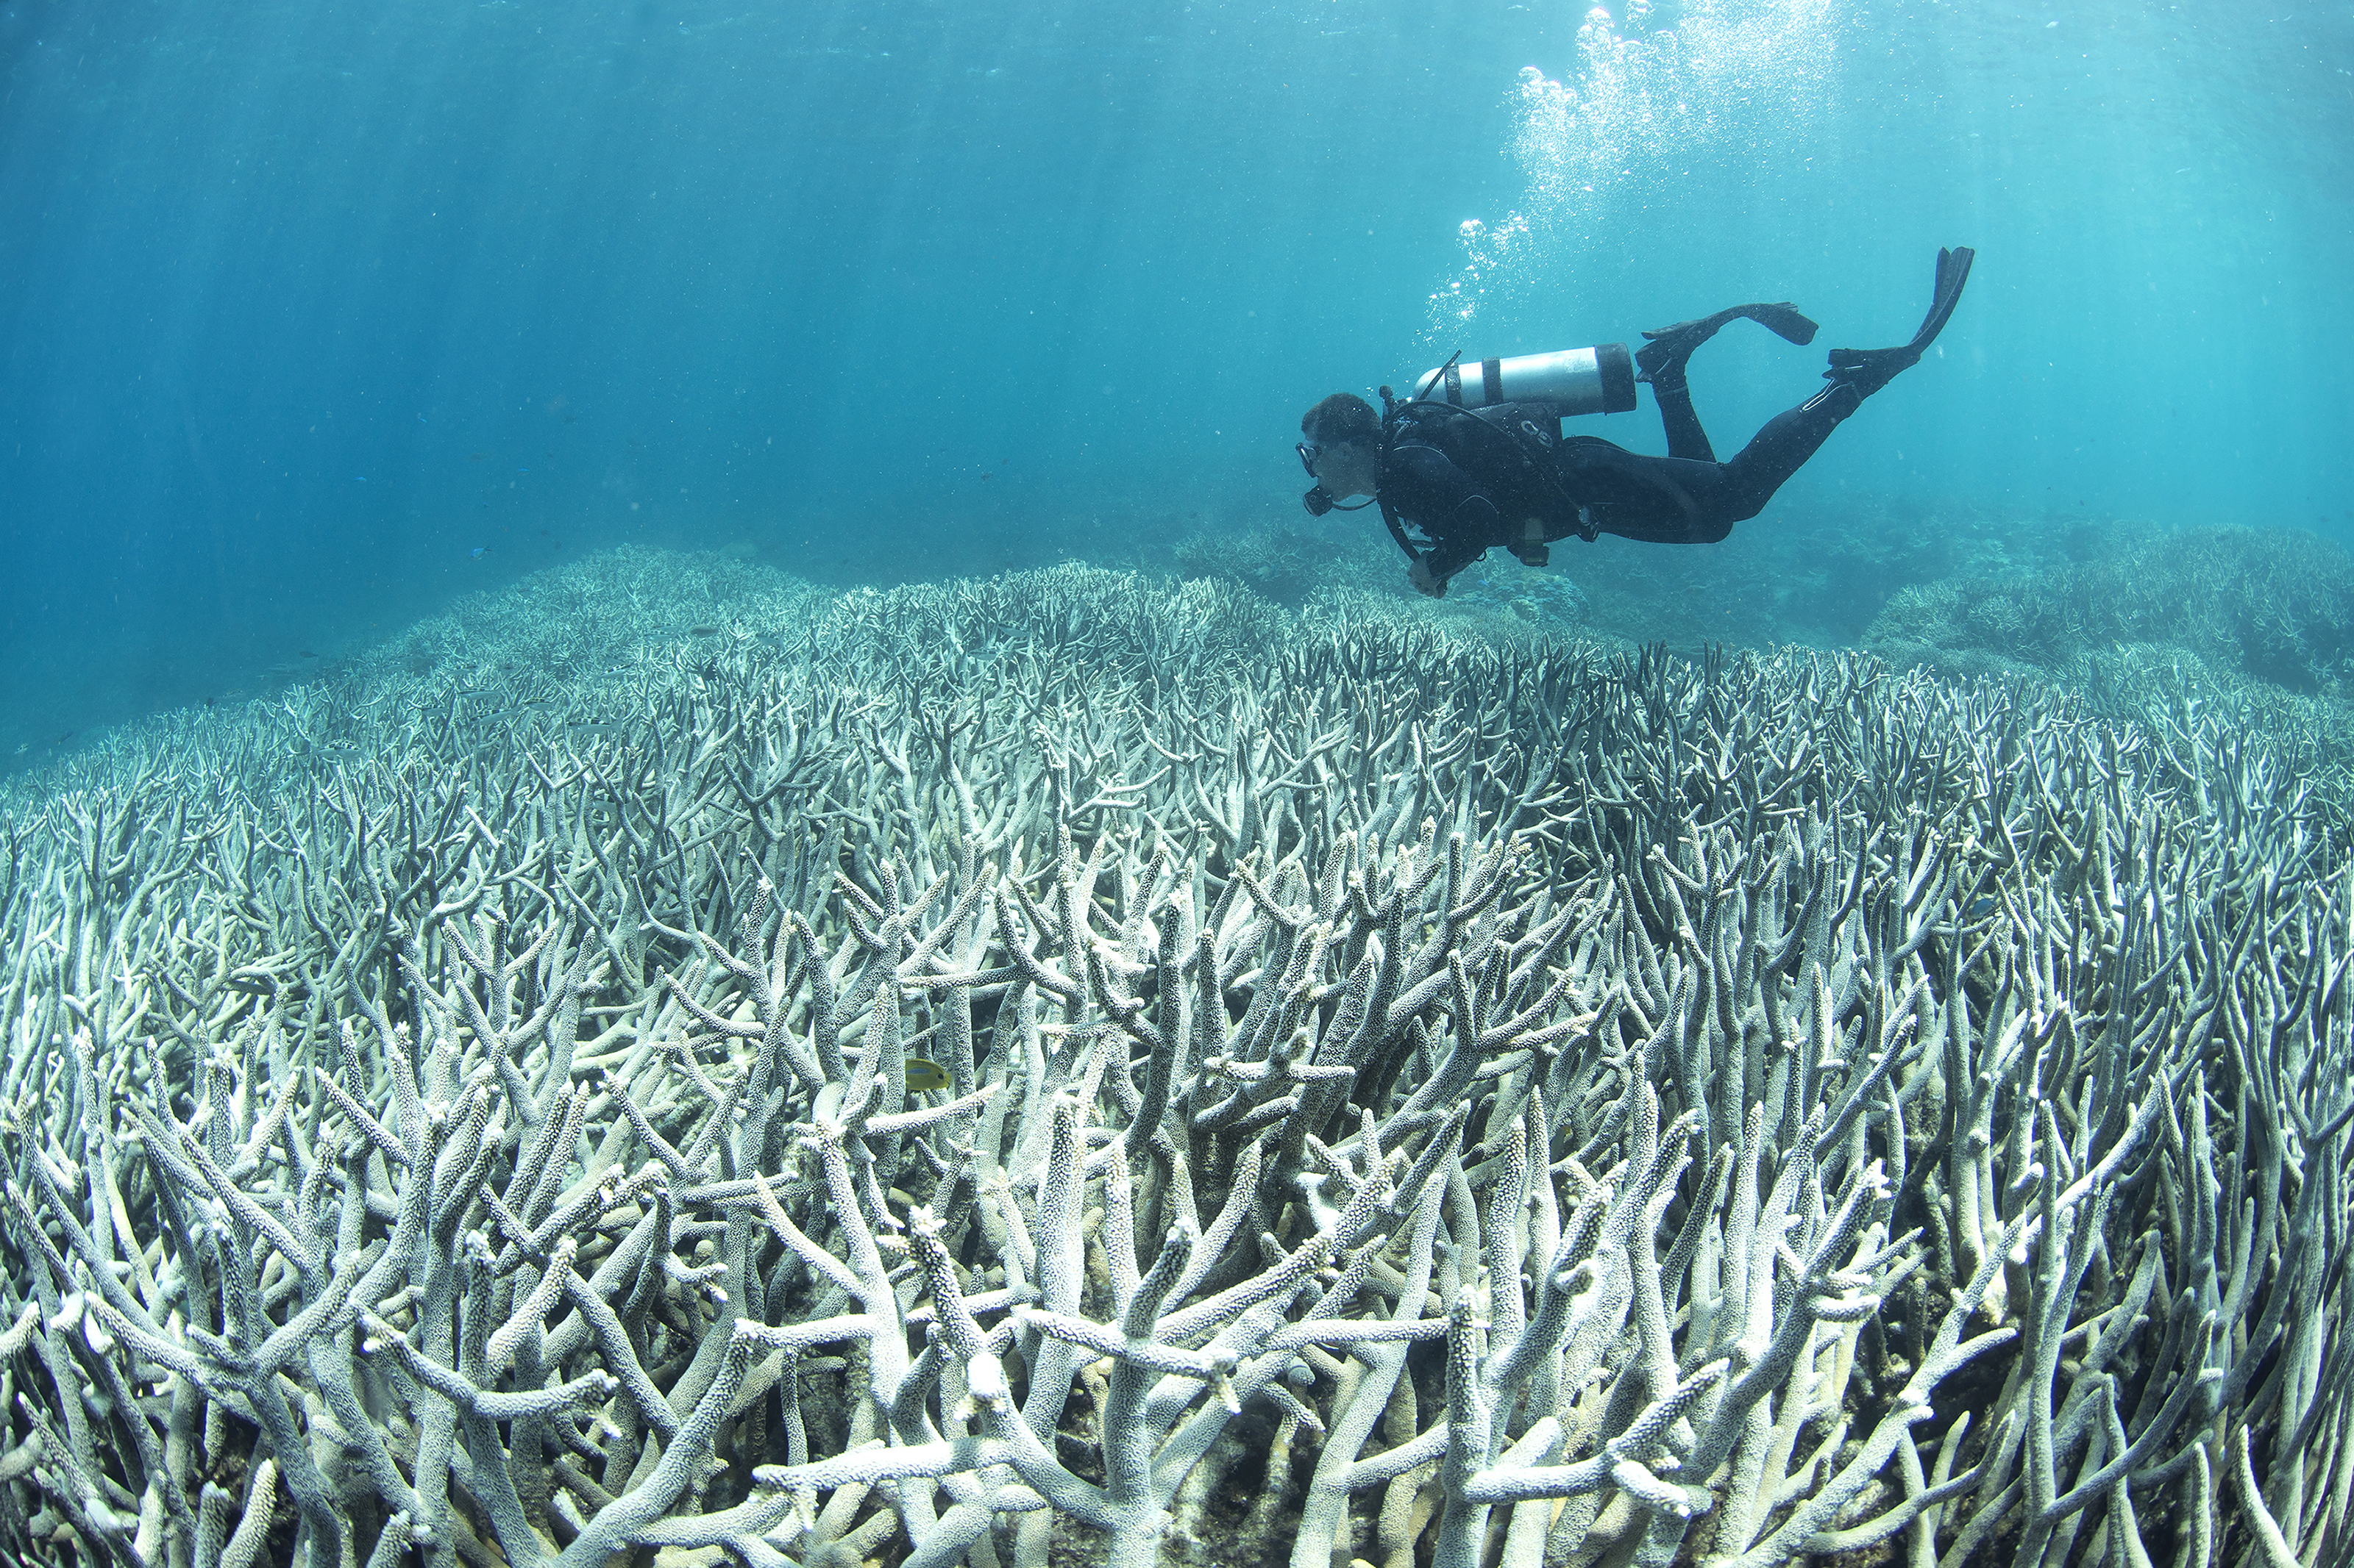
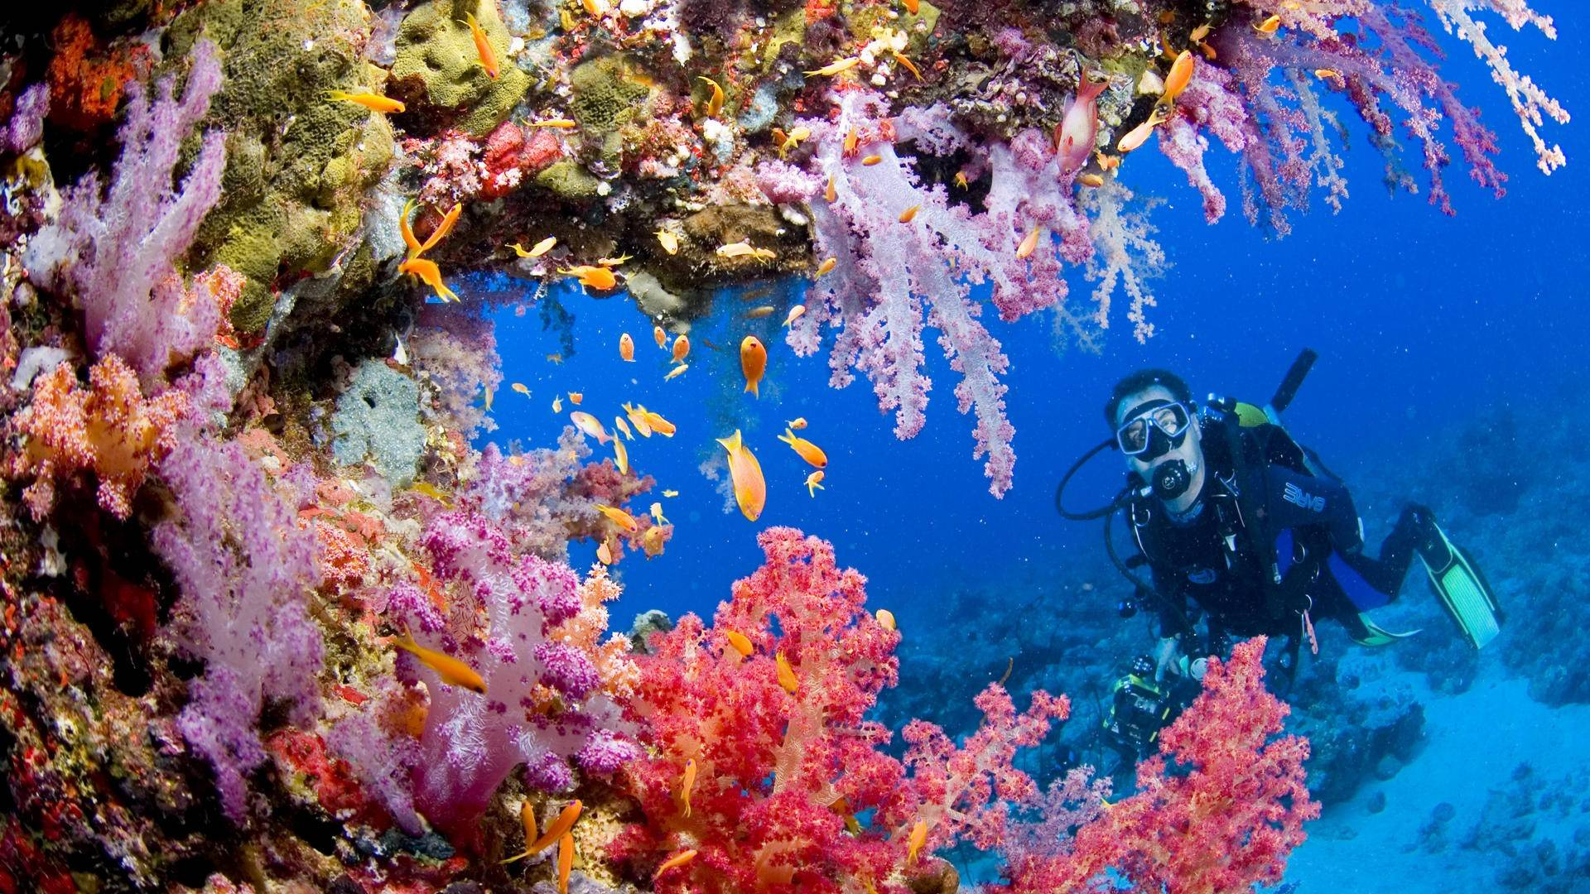

Slide 5
What is CORAL?
A central hub for real-time data from the National Oceanic and Atmospheric Administration
A tool for scientists to monitor reef stress around the world and compare world conditions to world bleaching percentages
An interactive and engaging way to encourage interest in protecting one of Earth’s most important and beautiful resources
Continuous monitoring of sea surface temperature at global scales provides researchers and stakeholders with tools to understand and better manage the complex interactions leading to coral bleaching. When bleaching conditions occur, these tools can be used to trigger bleaching response plans and support appropriate management decisions.

Slide 6
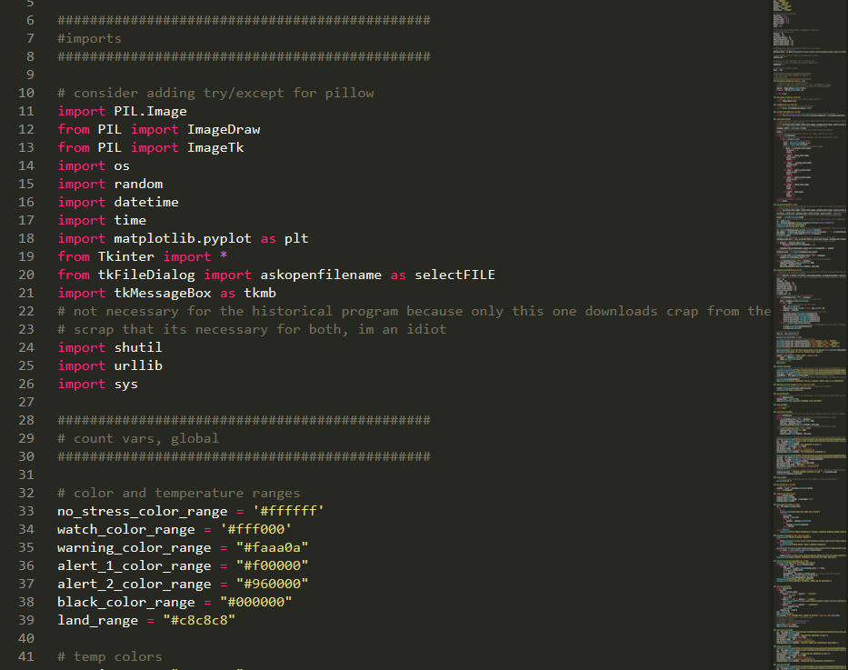
Built from the ground up with Python2.7
Coded 100% in Python
Modules used:
PIL (Python Image Library) for analysis of NOAA maps
MATPLOTLIB and PyRoot for graphing
Tkinter for GUI interactions
Urllib for image scraping
Why Python?
Extremely versatile
Easy GUI framework
Easier to allow newcomers to create additional functions for the software (due to readability of existing code)

Slide 7
A hub, a tool, an engager
CORAL is many things

Slide 8
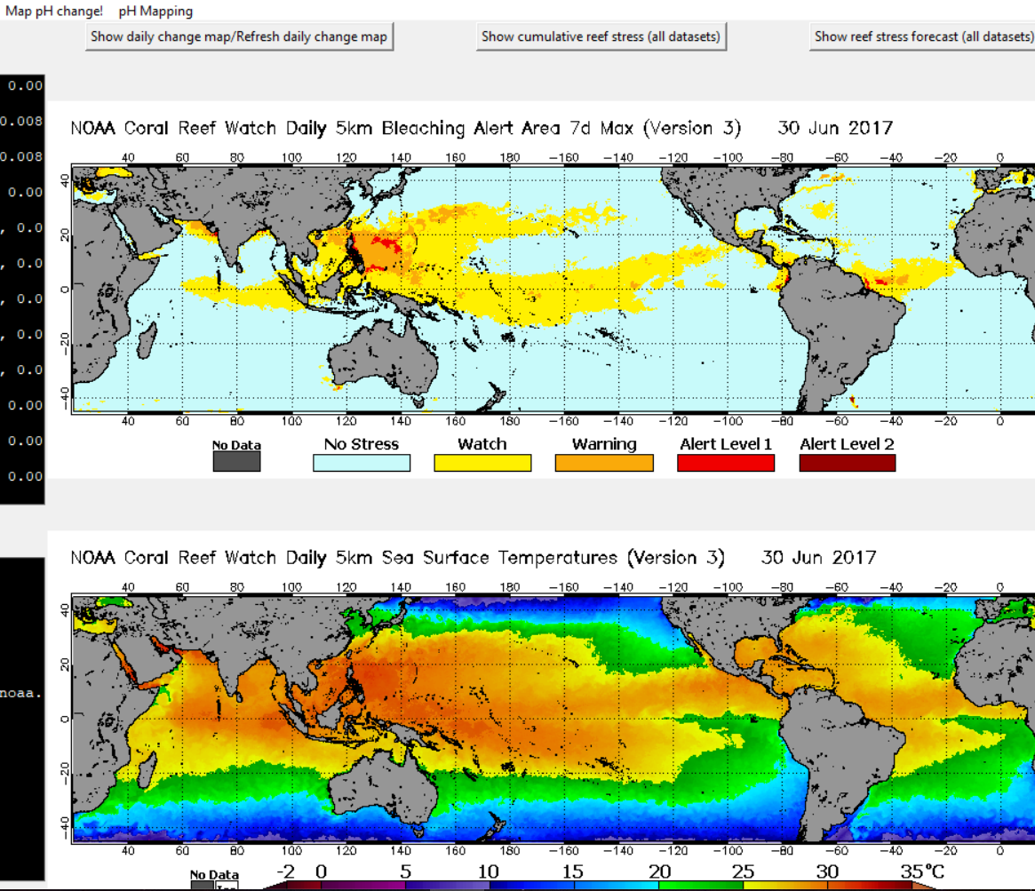
Central Hub for NOAA
Every day the NOAA puts out datasets and maps
Gathered from satellites, boats, and ground monitoring stations
Also in collaboration with NASA’s GFS and EarthWatch systems
CORAL groups all these maps in one location
Provides easy accessibility and interpretation
Colorful and easy-to-read maps are useful for interested parties and scientists alike

Slide 9
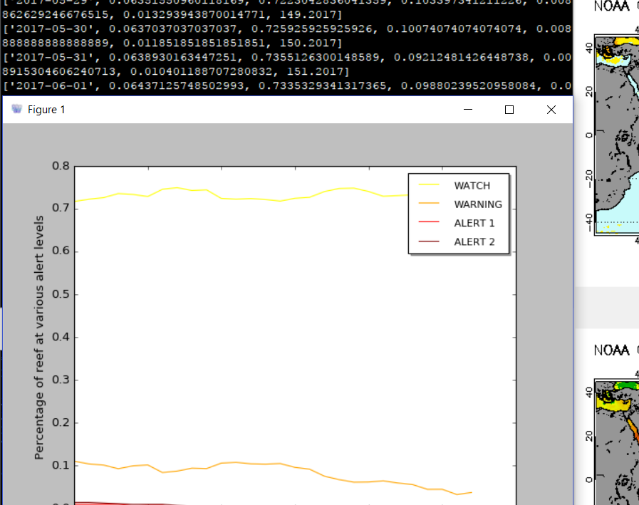
A Tool for Scientists
Keeps track of EVERYTHING
Percentage of coral reef bleaching worldwide
Percentage of coral reefs worldwide on bleaching alert status
Estimations of pH in 50kmx50km strips of ocean
Ocean temperatures
Graphs all over time
Provides integrated tools to compare any variable to the other and manipulate the datasets in anyway (with the exception of changing the contents)
This feature will be constantly under development

Slide 10
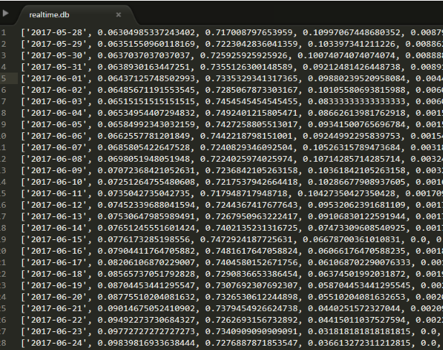
Dataset formatting
Datasets are organized like thus:
[individual, (data, bunches), identifier]
Individual
The timestamp that the program analyzed the data, this gives each element in the dataset a unique attribute and helps protect against confusing Python list methods
Data bunches
The data is stored in the middle section, usually as decimals representing some sort of percentage
Identifier
The program’s estimation of the date the NOAA gathered the data, in the form of (day_of_the_year.year) ex: 167.2017

Slide 11
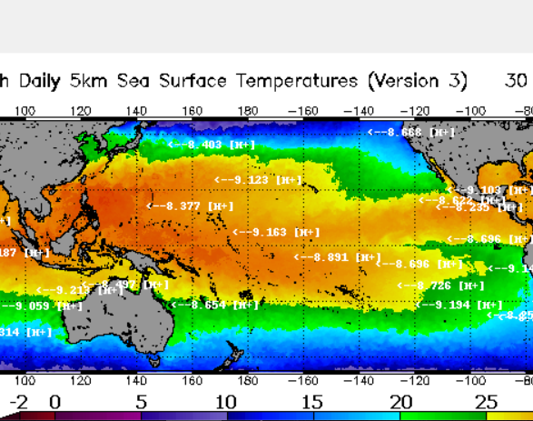
An engager for laymen
Also provides less-scientifically-important data and statistics
Not for studies but to engage people who download the program to learn more about reef bleaching
Non-scientists will also be kept update on global ocean CO2 ppm, pH flux, bleaching percentages, etc, but in a less data raw format
Provides opportunity for interested people to contribute
In the future, CORAL will be able to sync datasets from thousands of computers to provide millions of data points for scientists regarding temperature/pH changes vs bleaching all around the world, something no single computer can accomplish

Slide 12
Where to go from here?
Easier interface to graph multiple variables side-by-side
Integration of thousands of pH data points into one master dataset
Better integration with pyROOT
Provide on-tap explanations for maps
Use machine–learning and TensorFlow to improve predictions of coral reef bleaching
Improve UI
UI sometimes realigns when new maps are loaded

Slide 13
And now, for a live demo

